Slide 1
How a Host Routes
Notes:
8 – Network Layer
8.4 – How a Host Routes

Slide 2
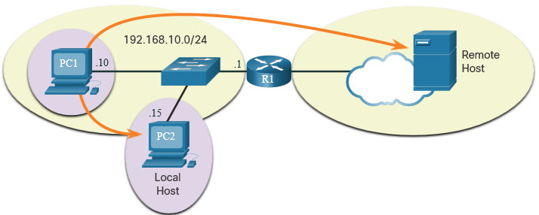
How a Host Routes Host Forwarding Decision
Packets are always created at the source.
Each host devices creates their own routing table.
A host can send packets to the following:
Itself – 127.0.0.1 (IPv4), ::1 (IPv6)
Local Hosts – destination is on the same LAN
Remote Hosts – devices are not on the same LAN
Notes:
8 – Network Layer
8.4 – How a Host Routes
8.4.1 – Host Forwarding Decision

Slide 3
How a Host Routes Host Forwarding Decision (Cont.)
The Source device determines whether the destination is local or remote
Method of determination:
IPv4 – Source uses its own IP address and Subnet mask, along with the destination IP address
IPv6 – Source uses the network address and prefix advertised by the local router
Local traffic is dumped out the host interface to be handled by an intermediary device.
Remote traffic is forwarded directly to the default gateway on the LAN.
Notes:
8 – Network Layer
8.4 – How a Host Routes
8.4.1 – Host Forwarding Decision (Cont.)

Slide 4
How a Host Routes Default Gateway
A router or layer 3 switch can be a default-gateway.
Features of a default gateway (DGW):
It must have an IP address in the same range as the rest of the LAN.
It can accept data from the LAN and is capable of forwarding traffic off of the LAN.
It can route to other networks.
If a device has no default gateway or a bad default gateway, its traffic will not be able to leave the LAN.
Notes:
8 – Network Layer
8.4 – How a Host Routes
8.4.2 – Default Gateway

Slide 5
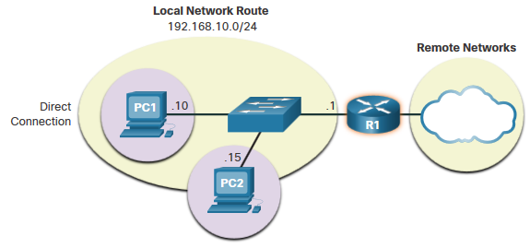
How a Host Routes A Host Routes to the Default Gateway
The host will know the default gateway (DGW) either statically or through DHCP in IPv4.
IPv6 sends the DGW through a router solicitation (RS) or can be configured manually.
A DGW is static route which will be a last resort route in the routing table.
All device on the LAN will need the DGW of the router if they intend to send traffic remotely.
Notes:
8 – Network Layer
8.4 – How a Host Routes
8.4.3 – A Host Routes to the Default Gateway

Slide 6
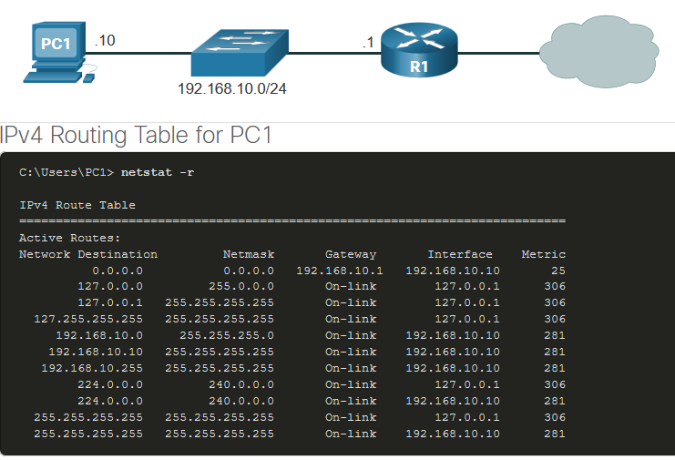
How a Host Routes Host Routing Tables
On Windows, route print or netstat -r to display the PC routing table
Three sections displayed by these two commands:
Interface List – all potential interfaces and MAC addressing
IPv4 Routing Table
IPv6 Routing Table
Notes:
8 – Network Layer
8.4 – How a Host Routes
8.4.4 – Host Routing Tables
8.4.5 – Check Your Understanding – How a Host Routes

Slide 7
Introduction to Routing
Notes:
8 – Network Layer
8.5 – Introduction to Routing

Slide 8
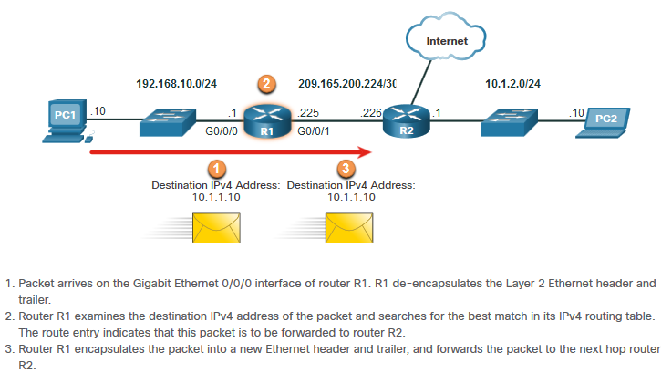
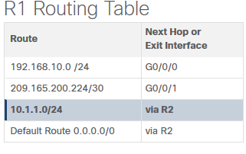
Introduction to Routing Router Packet Forwarding Decision
What happens when the router receives the frame from the host device?
Notes:
8 – Network Layer
8.5 – Introduction to Routing
8.5.1 – Router Packet Forwarding Decision

Slide 9
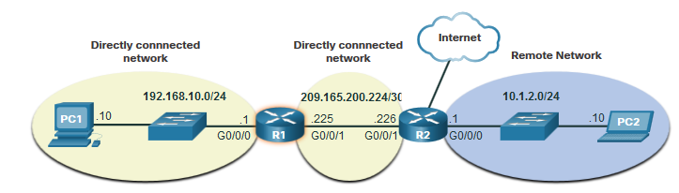
Introduction to Routing IP Router Routing Table
There three types of routes in a router’s routing table:
Directly Connected – These routes are automatically added by the router, provided the interface is active and has addressing.
Remote – These are the routes the router does not have a direct connection and may be learned:
Manually – with a static route
Dynamically – by using a routing protocol to have the routers share their information with each other
Default Route – this forwards all traffic to a specific direction when there is not a match in the routing table
Notes:
8 – Network Layer
8.5 – Introduction to Routing
8.5.2 – IP Router Routing Table

Slide 10
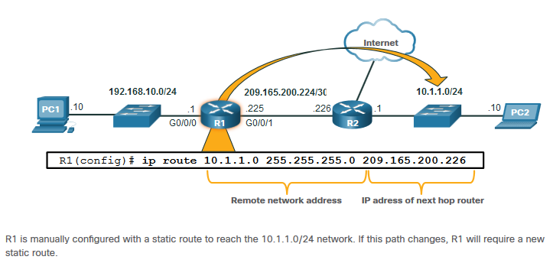
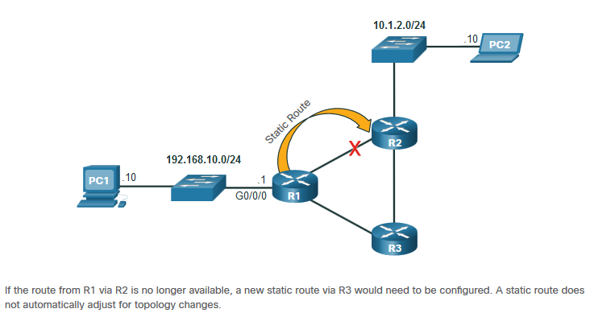
Introduction to Routing Static Routing
Static Route Characteristics:
Must be configured manually
Must be adjusted manually by the administrator when there is a change in the topology
Good for small non-redundant networks
Often used in conjunction with a dynamic routing protocol for configuring a default route
Notes:
8 – Network Layer
8.5 – Introduction to Routing
8.5.3 – Static Routing

Slide 11
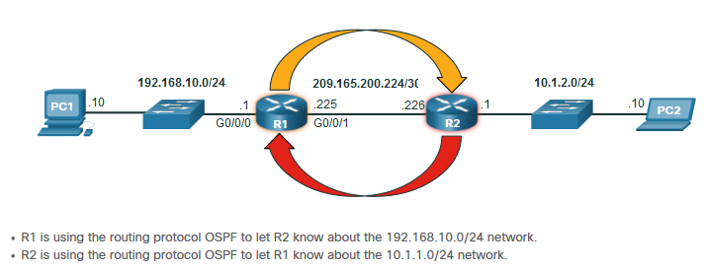
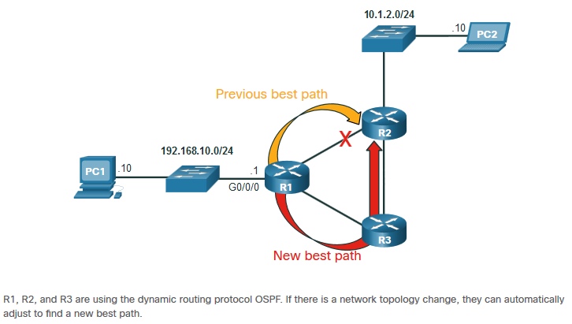
Introduction to Routing Dynamic Routing
Dynamic Routes Automatically:
Discover remote networks
Maintain up-to-date information
Choose the best path to the destination
Find new best paths when there is a topology change
Dynamic routing can also share static default routes with the other routers.
Notes:
8 – Network Layer
8.5 – Introduction to Routing
8.5.4 – Dynamic Routing

Slide 12
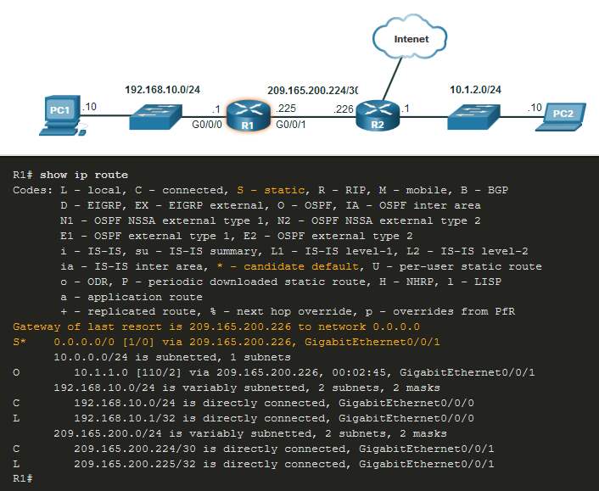
Introduction to Routing Introduction to an IPv4 Routing Table
The show ip route command shows the following route sources:
L - Directly connected local interface IP address
C – Directly connected network
S – Static route was manually configured by an administrator
O – OSPF
D – EIGRP
This command shows types of routes:
Directly Connected – C and L
Remote Routes – O, D, etc.
Default Routes – S*
Notes:
8 – Network Layer
8.5 – Introduction to Routing
8.5.6 – Introduction to an IPv4 Routing Table
8.5.7 – Check Your Understanding – Introduction to Routing

Slide 13
Network Layer New Terms and Commands
netstat –r
route print
interface list
IPv4 Route Table
IPv6 Route Table
directly-connected routes
remote routes
default route
show ip route
route source
destination network
outgoing interface
administrative distance
metric
next-hop
route timestamp
Notes:
New Terms and Commands

